Slide 1
TOPICS
Basics of Learning theory
Design of learning System.
Introduction to Concept Learning.
Modeling in Machine Learning.

Slide 2
Introduction to learning
The process of acquiring knowledge and expertise through study, experience, or being taught is called as learning.
Learning types/methods
Learn by memorization
Learn by examples
Learn by being taught
Learning by critical thinking
Self learning
Learning to solve problems
Learning by generalizing explanations

Slide 3
According to Tom Mitchell, “A computer program is said to be learning from experience (E), with respect to some task (T). Thus, the performance measure (P) is the performance at task T, which is measured by P, and it improves with experience E.”
Example: In Spam E-Mail detection,
Task, T: To classify mails into Spam or Not Spam.
Performance measure, P: Total percent of mails being correctly classified as being “Spam” or “Not Spam”.
Experience, E: Set of Mails with label “Spam”

Slide 4
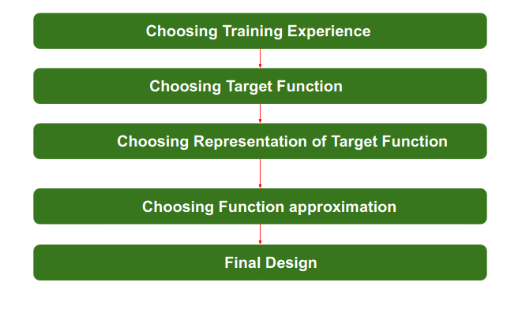
Design of a learning system
A system that is built around a learning algorithm is called a learning system.
steps
Choosing a training experience
Choosing a target function
Representation of a target function
Function approximation

Slide 5
Training experience
It is important to note that the data or experience that we fed to the algorithm must have a significant impact on the Success or Failure of the Model. So Training data or experience should be chosen wisely.
The training experience will be able to provide direct or indirect feedback regarding choices. For example: While Playing chess the training data will provide feedback to itself like instead of this move if this is chosen the chances of success increases.

Slide 6
Choosing target function
According to the knowledge fed to the algorithm the machine learning will choose NextMove function which will describe what type of legal moves should be taken.
For example : While playing chess with the opponent, when opponent will play then the machine learning algorithm will decide what be the number of possible legal moves taken in order to get success.

Slide 7
Representation for Target function
When the machine algorithm will know all the possible legal moves the next step is to choose the optimized move
For Example : while playing chess machine have 4 possible moves, so the machine will choose that optimized move which will provide success to it.

Slide 8
Function Approximation Algorithm
An optimized move cannot be chosen just with the training data. The training data had to go through with set of example and through these examples the training data will approximates which steps are chosen and after that machine will provide feedback on it.
For Example : When a training data of Playing chess is fed to algorithm so at that time it is not machine algorithm will fail or get success and again from that failure or success it will measure while next move what step should be chosen and what is its success rate.

Slide 9
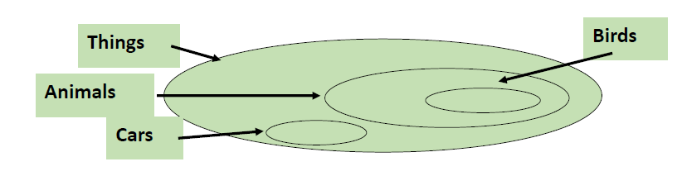
Introduction to concept learning
A Concept is a subset of objects or events defined over a larger set [Example: The concept of a bird is the subset of all objects (i.e., the set of all things or all animals) that belong to the category of bird.]
Alternatively, a concept is a boolean-valued function defined over this larger set [Example: a function defined over all animals whose value is true for birds and false for every other animal].

Slide 10
What is Concept-Learning?
• Given a set of examples labeled as members or non-members of a concept, concept-learning consists of automatically inferring the general definition of this concept.
• In other words, concept-learning consists of approximating a Boolean-valued function from training examples of its input and output.

Slide 11
Concept learning requires three things
Input: training dataset which is a set of training instances, each labelled with the name of a concept. Use this past experience to train and build the model.
Output: target function f. it is a mapping function f(x) from input x output y. it is to determine specific features to identify an object.
Test: new instances to test the learned model.

Slide 12
A Concept Learning Task
Consider the example task of learning the target concept "days on which my friend Aldo enjoys his favorite water sport.“
• Table describes a set of example days, each represented by a set of attributes.
• The attribute Enjoy Sport indicates whether or not Aldo enjoys his favorite water sport on this day.
• The task is to learn to predict the value of Enjoy Sport for an arbitrary day, based

Slide 13
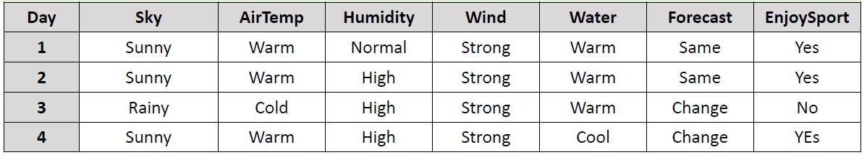
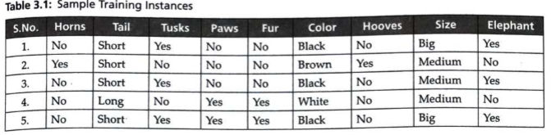
Table 2.1 Positive & negative training examples for the target concept EnjoySport.

Slide 14
Representation of Hypothesis
Hypothesis ‘h’ approximates a target function ‘f’ t represent the relationship between the independent attributes and the dependent attribute of the training instances.
It predicts the model that best maps the inputs to outputs.
Each hypothesis is represented in conjunction of attribute conditions.
Example: (sky=sunny) ^ ( wind=strong)
Conjunction of constraints on each attribute where:
  “?” means “any value is acceptable”( sky=?)
  single values denotes a specific single value from acceptable values of the attributes (wind=strong)
  “∅” means “no value is acceptable” (rain= ∅)

Slide 15
Example of a hypothesis: <?, Cold, High, ?, ?, ?> (If the air temperature is cold and the humidity high then it is a good day for water sports)
Goal: To infer the “best” concept-description from the set of all possible hypotheses (“best” means “which best generalizes to all (known or unknown) elements of the instance space” concept-learning is an ill-defined task)
The most general hypothesis-that every day is a good day for water sports, positive example-is represented by
<?, ?, ?, ?, ?, ?>
The most specific possible hypothesis-that no day is a positive example-is represented by <0,0,0,0,0,0>

Slide 16
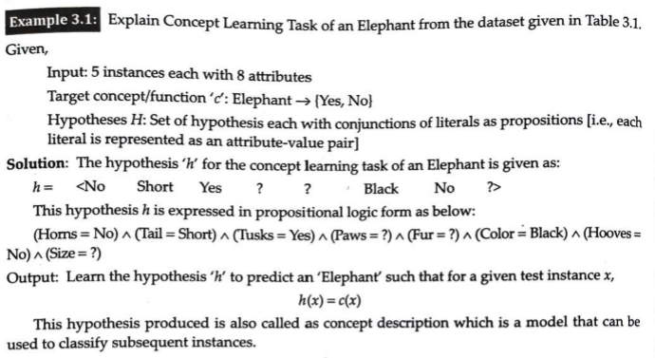

Slide 17
Hypothesis Space
Hypothesis space is the set of all the possible legal hypothesis. This is the set from which the machine learning algorithm would determine the best possible (only one) which would best describe the target function or the outputs.

Slide 18
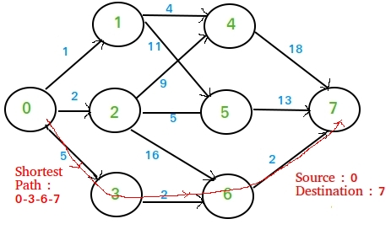
Heuristic Space Search
Heuristics operates on the search space of a problem to find the best or closest-to-optimal solution via the use of systematic algorithms.

Slide 19
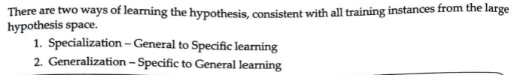
Generalization and Specialization

Slide 20
Find-S, a Maximally Specific Hypothesis Learning Algorithm
Problem1: Implement and demonstrate the FIND-S algorithm for finding the most specific hypothesis based on a given set of training data samples. Read the training data from a .CSV file.
Algorithm:
1. Initialize h to the most specific hypothesis in H
2. For each positive training instance x
For each attribute constraint ai in h
If the constraint ai in h is satisfied by x then do nothing
else replace ai in h by the next more general constraint that is satisfied by x
3. Output hypothesis h

Slide 21
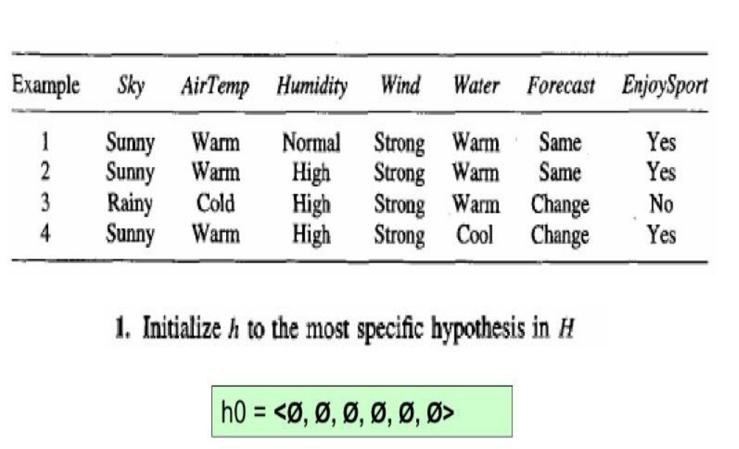
Illustration:
Step1: Find S

Slide 22
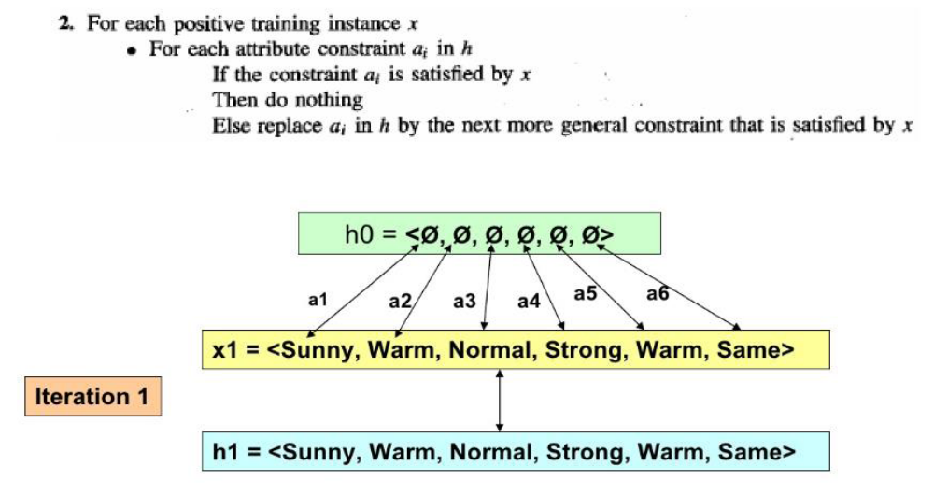
Step2: Find S

Slide 23
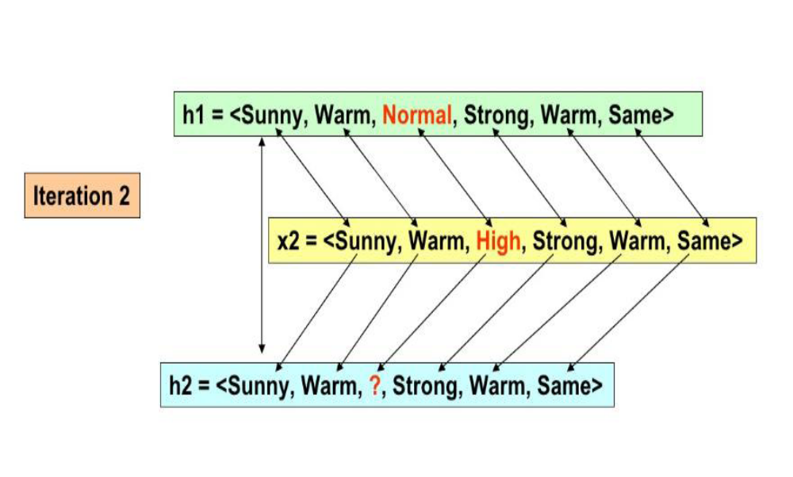
Step2: Find S

Slide 24
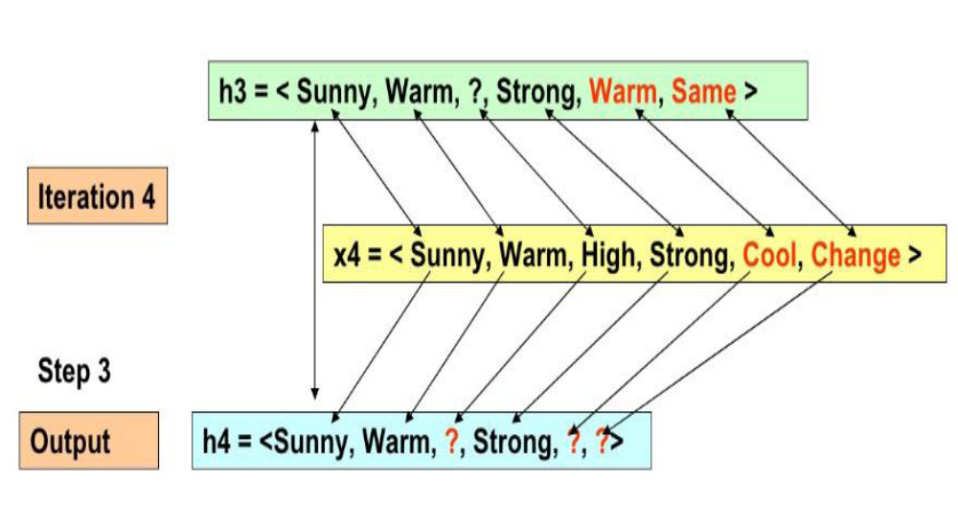
Iteration 3 and Step 4: Find S

Slide 25
Properties of Find-S
Hypothesis space described by conjunctions of attributes
Find-S will output the most specific hypothesis within H that is consistent with the positive training examples
The output hypothesis will also be consistent with the negative examples, provided the target concept is contained in H.
v
limitations of Find-S
to find a hypothesis that is consistent with positive instances, ignoring all negative instances. As long as the training dataset is consistent, the hypothesis found by this algorithm is consistent.
The algorithm finds only one unique hypothesis, where in there may be many other hypothesis that are consistent with the training dataset.
Inconsistent data instances can mislead this algorithm in determining the consistent hypothesis.

Slide 26
Complaints about Find-S
Can’t tell if the learner has converged to the target concept, in the sense that it is unable to determine whether it has found the only hypothesis consistent with the training examples.
Can’t tell when training data is inconsistent, as it ignores negative training examples.
Why prefer the most specific hypothesis?
What if there are multiple maximally specific hypothesis?

Slide 27


Slide 28
Similarity-based Learning

Slide 29
Instance Based Learning : Introduction
Introduction, k-nearest neighbor learning, locally weighted regression, radial basis function, cased-based reasoning,

Slide 30
5.2Instance Based Learning : Introduction
• All learning methods presented so far construct a general explicit description of the target function when examples are provided.
• IBL methods simply store the training examples instead of learning explicit description of the target function.
• Generalizing the examples is postponed until a new instance must be classified .
• When a new instance is encountered , its relationship to the stored examples is examined in order to assign a target function value for the new instance.

Slide 31
• Memory-based learning(also called instance-based learning) is a type of learning algorithm that compares new test data with training data in order to solve the given machine learning problem. Such algorithms search for the training data that are most similar to the test data and make predictions based on these similarities.
• Learning in these algorithms consists of simply storing the presented training data. When a new query instance is encountered a set of similar related instances is retrieved from memory and used to classify the new query instance
• Examples :k-nearest neighbor learning , locally weighted regression, Radial Basis function (RBF), kernel machines and Case based Reasoning .

Slide 32
Key Advantage
Instead of estimating the target function once for the entire data set (which can lead to complex and not necessarily accurate functions) IBL can estimate the required function locally and differently for each new instance to be classified.

Slide 33
Advantages
•Instead of estimating for the whole instance space, local approximations to the target function are possible.
•Especially if target functions is complex but still decomposable
Disadvantages
•Classification costs are high
•Typically all attributes are considered when attempting to retrieve similar training examples.

Slide 34
k-NEAREST NEIGHBOR LEARNING
The most basic instance-based method is the k-NEAREST NEIGHBOR algorithm. This algorithm assumes all instances correspond to points in the n-dimensional space 𝑅𝑛.
The nearest neighbors of an instance are defined in terms of the standard Euclidean distance.

Slide 35

More precisely let an arbitrary instance x be described by the feature vector (set of attributes) as follows :<a(x)₁, a(x)₂, …a_{n}(x)
where ar(x)denotes the value of the rth attribute of instance x. Then the Euclidean distance between two instances xi and xj is defined to be d(xi, xj)where

Slide 36
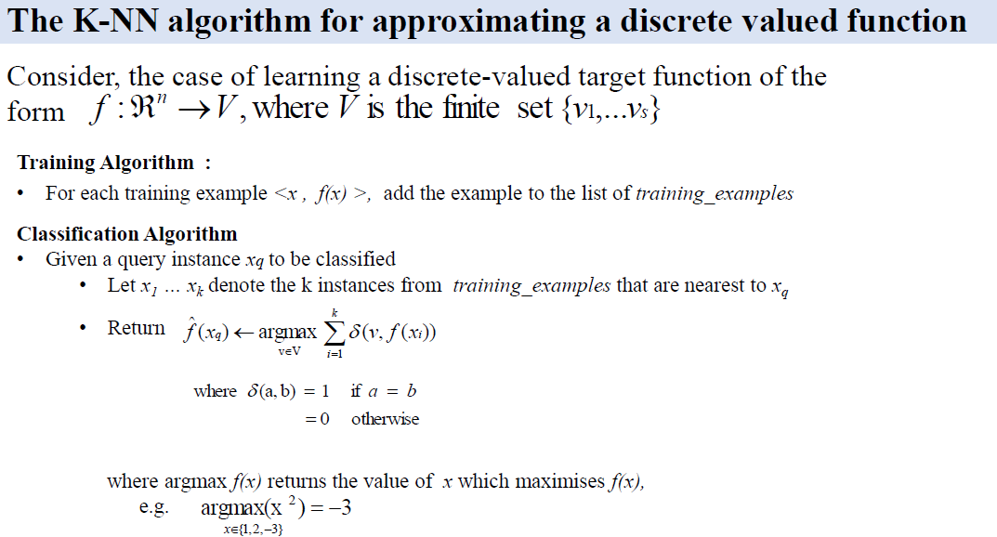

Slide 37
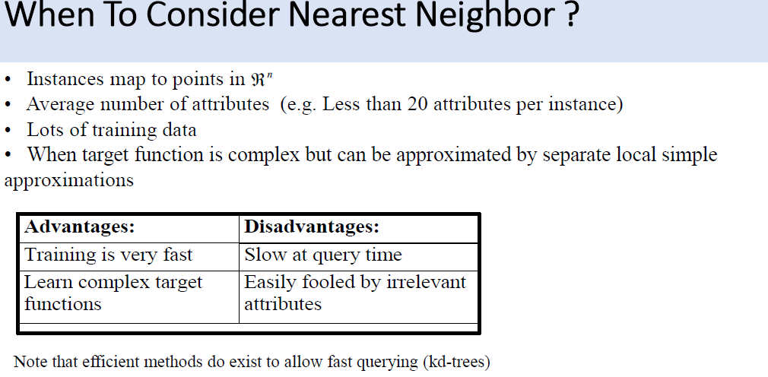

Slide 38
KNN Performance
The performance of the KNN Algorithm is influenced by three main factors :
1.The distance function or distance metric used to determine the nearest neighbors
2.The decision rule used to derive a classification from the K nearest neighbors
3.The number of neighbors used to classify the new example.

Slide 39
Advantages
•The KNN algorithm is very easy to implement
•Nearly optimal in the large sample limit
•Uses local information which can yield highly adaptive behavior
•Lends itself very easily to parallel implementation
Disadvantages
•Large storage requirements
•Computationally intensive recall
•Highly susceptible to the curse of dimensionality

